Slide 1
The Great GPT Model
Briefly Explaining GPT Applications
WangJing
2023-05-11

Slide 2
CONTENTS
Introduction - Abilities of GPT Technology
Some Applications
Conclusion and Thanks

Slide 3
01
Introduction - Abilities of GPT Technology

Slide 4
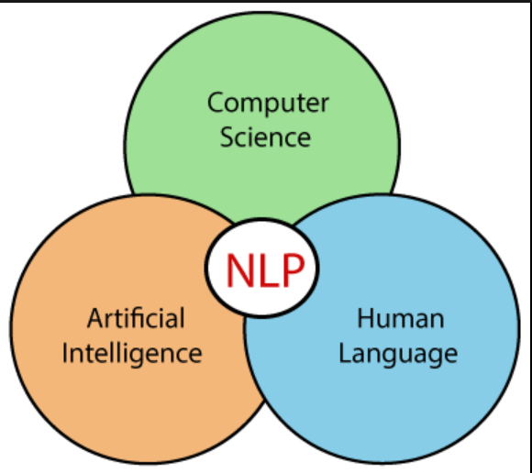

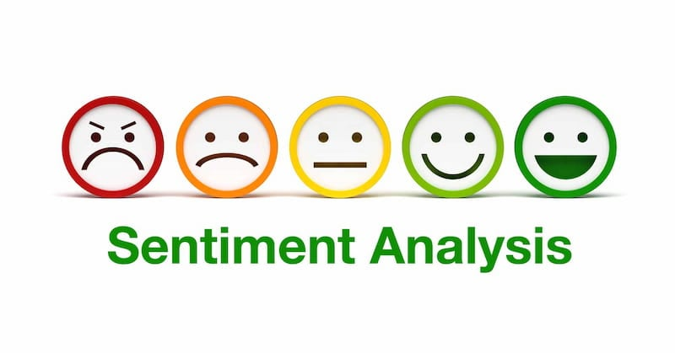
Introduction - Abilities of GPT Technology
1. Natural Language Understanding 5.Image Processing
2. Text Generation
3. Translation
4. Sentiment Analysis(情感分析)

Slide 5

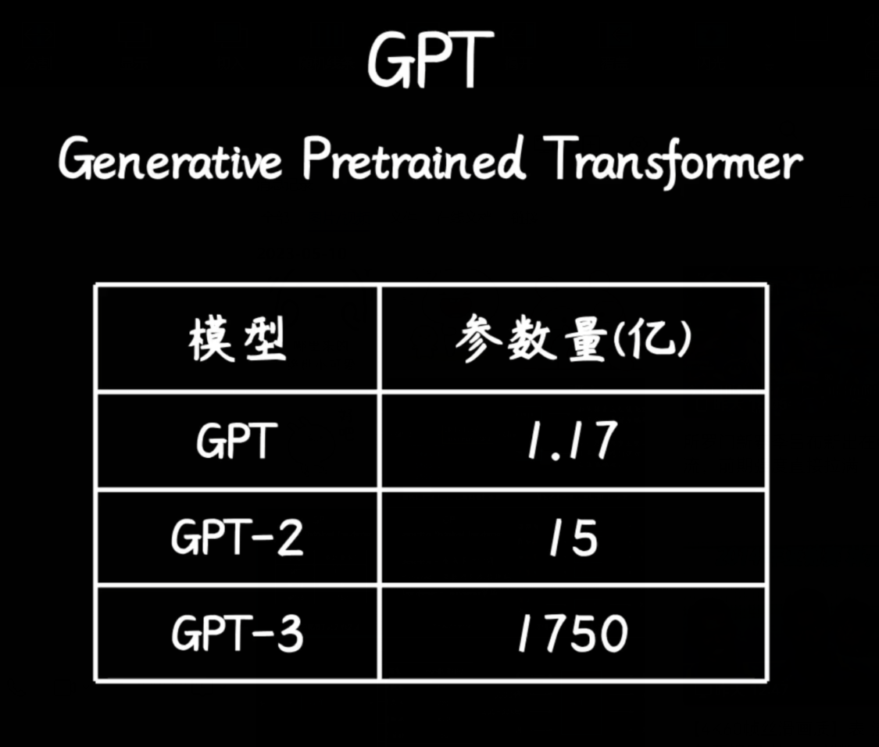
Introduction –Overview of GPT Principle
GPT is essentially a probabilistic model!

Slide 6
02
Some Applications

Slide 7
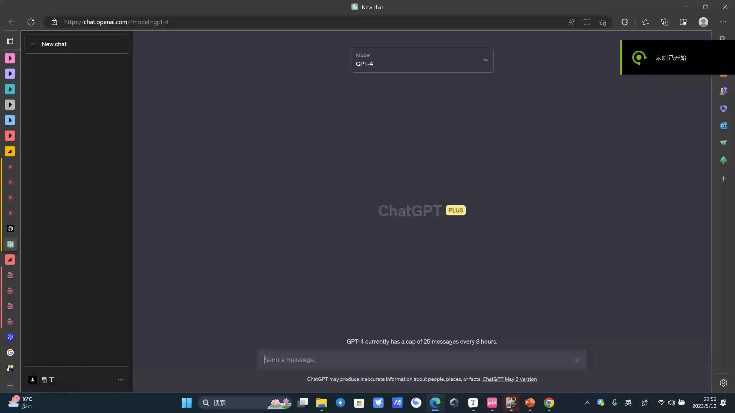
Content – Some Applications
ChatBot

Slide 8
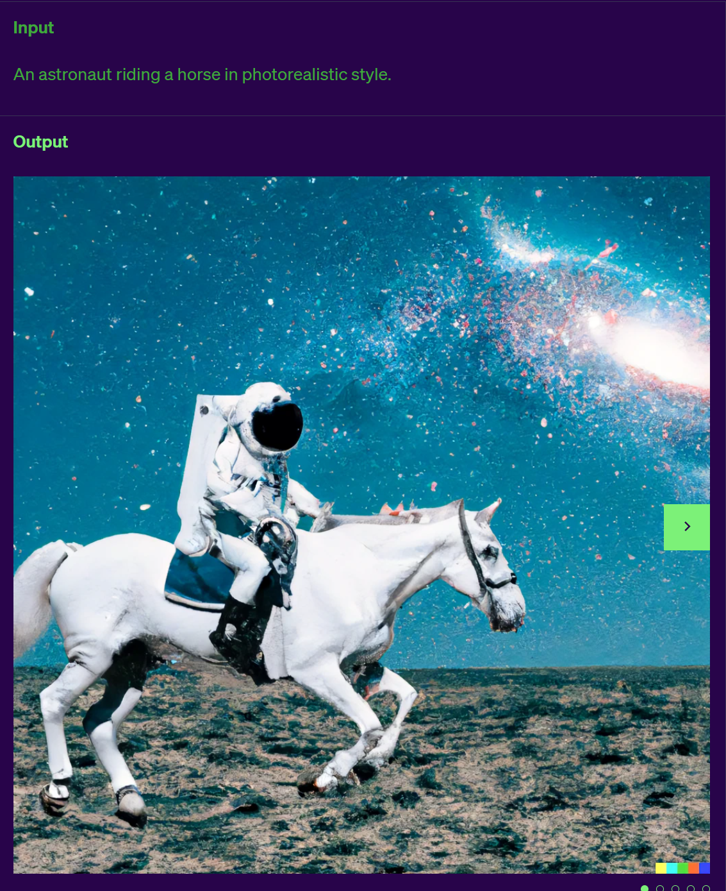
Introduction – Some Applications
Image generation(GPT-4)

Slide 9
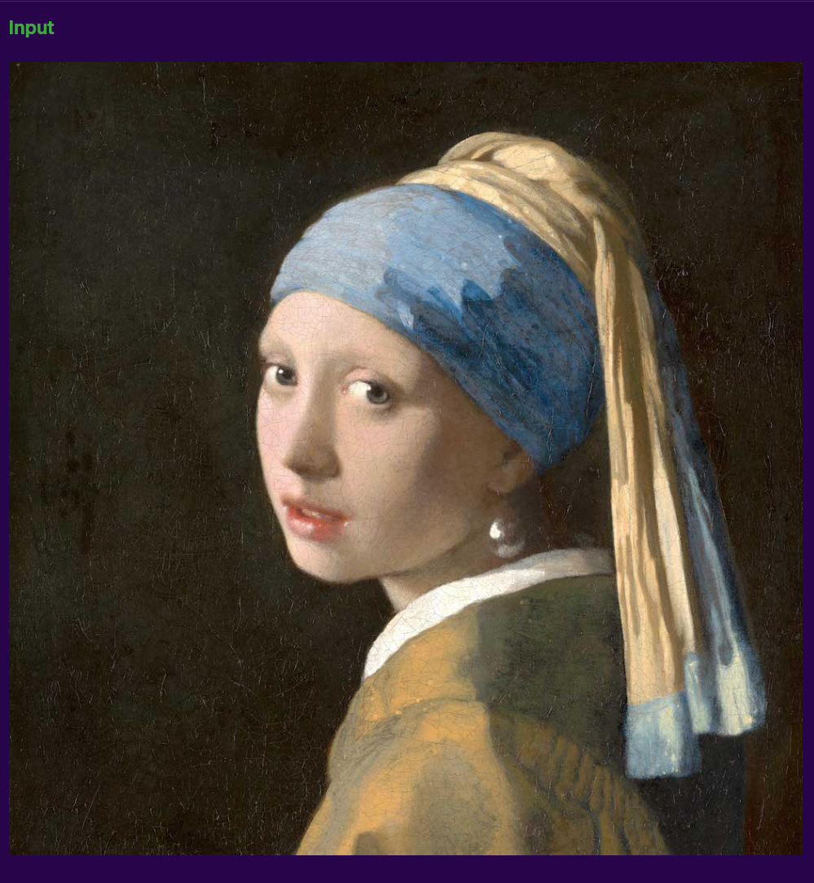
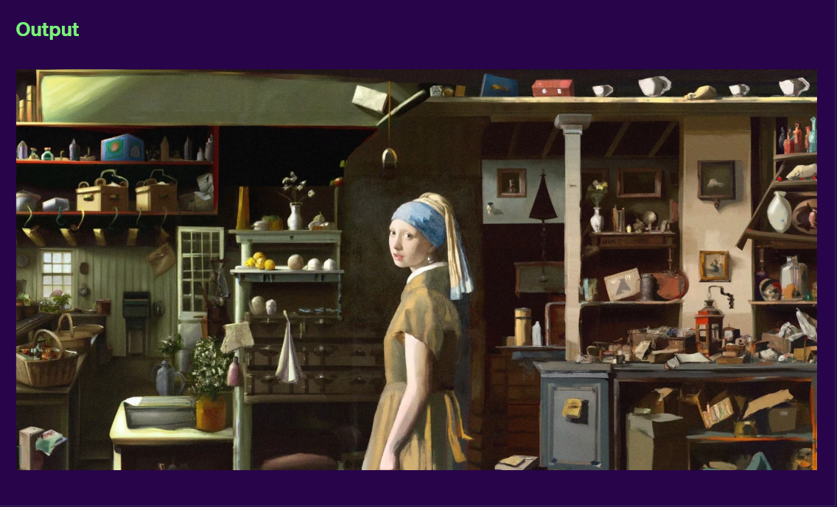
Introduction – Some Applications
Image expansion(GPT-4)

Slide 10
03
Conclusion and Thanks

Slide 11
Conclusion and Thanks
Thank you for your attention. I invite you all to share your valuable opinions and questions.

Slide 12
THE END
THANKS

